Slide 1
Improved sources of drinking Water
CAPSTONE PROJECT
Presented By-
Avantika Kashyap
Haridwar University
B-tech cse (AI&ML)

Slide 2
OUTLINE
Problem Statement (Should not include solution)
Proposed System/Solution
System Development Approach (Technology Used)
Algorithm & Deployment
Result (Output Image)
Conclusion
Future Scope
References

Slide 3
Problem Statement
The Challenge: Access to safe and improved sources of drinking water remains a critical issue in India, especially in rural and underdeveloped regions. Despite ongoing efforts under the Sustainable Development Goals (SDGs), inequalities persist in water accessibility across states and socio-economic groups. This project aims to analyze data from the 78th Round of the Multiple Indicator Survey (MIS) to assess the percentage of the population with access to improved drinking water sources. It will also explore related indicators such as use of clean cooking fuel and migration trends. By identifying patterns and disparities, the study will generate actionable insights to support evidence-based policymaking. The ultimate goal is to help ensure equitable access to clean water and contribute to India's progress on SDG targets.

Slide 4
Proposed Solution
The proposed system aims to address the challenge of assessing and predicting access to improved sources of drinking water across different regions and population groups in India. The solution will help generate actionable insights to support evidence-based policymaking and monitor progress toward Sustainable Development Goal (SDG) targets.
The solution will consist of the following components:
Data Collection:
Collect data from the 78th Round of the Multiple Indicator Survey (MIS), focusing on indicators related to improved drinking water sources, clean cooking fuel usage, and migration patterns.
Data Preprocessing:
Clean and preprocess the collected data by handling missing values, inconsistencies, and outliers.
Normalize and encode categorical variables such as state, gender, and indicator for effective model training.
Machine Learning Algorithm:
Implement a supervised machine learning regression model to predict the Value (percentage of population with access to improved drinking water).
Algorithms such as Linear Regression, Random Forest Regression, or Gradient Boosting can be used to capture both linear and non-linear relationships in the data.
Deployment:
Develop a dashboard or web-based interface that visualizes predicted water access levels across states and demographic groups.
Deploy the system on a scalable platform to allow policymakers, researchers, and stakeholders to access real-time insights and comparative analyses.
Evaluation:
Evaluate the model’s performance using metrics such as Mean Absolute Error (MAE), Root Mean Squared Error (RMSE), and R-squared.
Continuously refine the model through feedback, updated survey data, and monitoring of prediction accuracy to ensure reliable and relevant outputs.

Slide 5
System Approach
The system approach defines the methodology used to analyze and predict access to improved drinking water sources using survey data and machine learning techniques
. The system follows a structured pipeline consisting of data acquisition, preprocessing, model development, evaluation, and result visualization to support evidence-based decision-making.

Slide 6
Technologies used
IBM cloud lite services
Natural Language Processing (NLP)
Retrieval Augmented Generation (RAG)
IBM Granite model

Slide 7
Algorithm & Deployment
Algorithm Selection:
Random Forest and Logistic Regression are used to analyze and predict access to improved drinking water. They are suitable for survey data and help identify important socio-economic and regional factors.
Data Input:
Household location (rural/urban, state)
Socio-economic details (income, education, household size)
Access to drinking water
Migration status
Training Process:
Data is preprocessed by handling missing values and encoding variables. The dataset is split into training and testing sets. Cross-validation and hyperparameter tuning are used to improve accuracy.
Prediction Process:
The trained model predicts the probability of households having access to improved drinking water and identifies vulnerable regions for policy planning.
Deployment
Deployment Platform:
The model can be deployed using dashboards or web applications (Python, Power BI, Tableau).
User Interaction:
Users can input regional data to get predictions, risk classification, and visual reports.
Real-Time Updates:
The system can be updated with new survey data for continuous monitoring.
Benefits:
Supports policymakers, improves resource planning, and helps track SDG progress.

Slide 8
Result
The analysis identified variations in access to improved drinking water across different states and socio-economic groups.
Rural and economically weaker regions showed comparatively lower access to safe drinking water sources.
A strong relationship was observed between access to clean cooking fuel and improved drinking water availability.
Migration trends indicated that lack of basic facilities like safe water may influence population movement.
The model successfully helped in identifying vulnerable regions, supporting better policy planning and resource allocation.

Slide 9
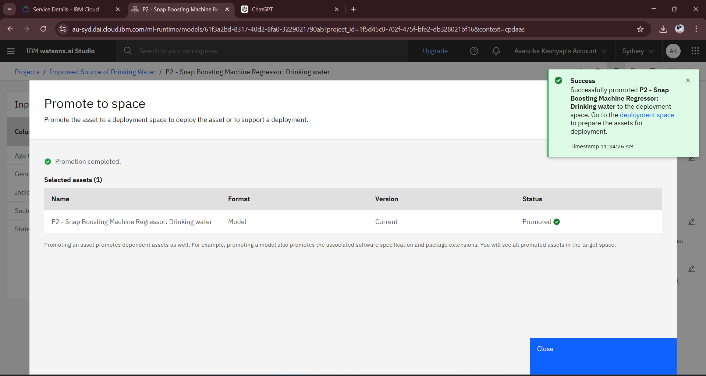
Result

Slide 10
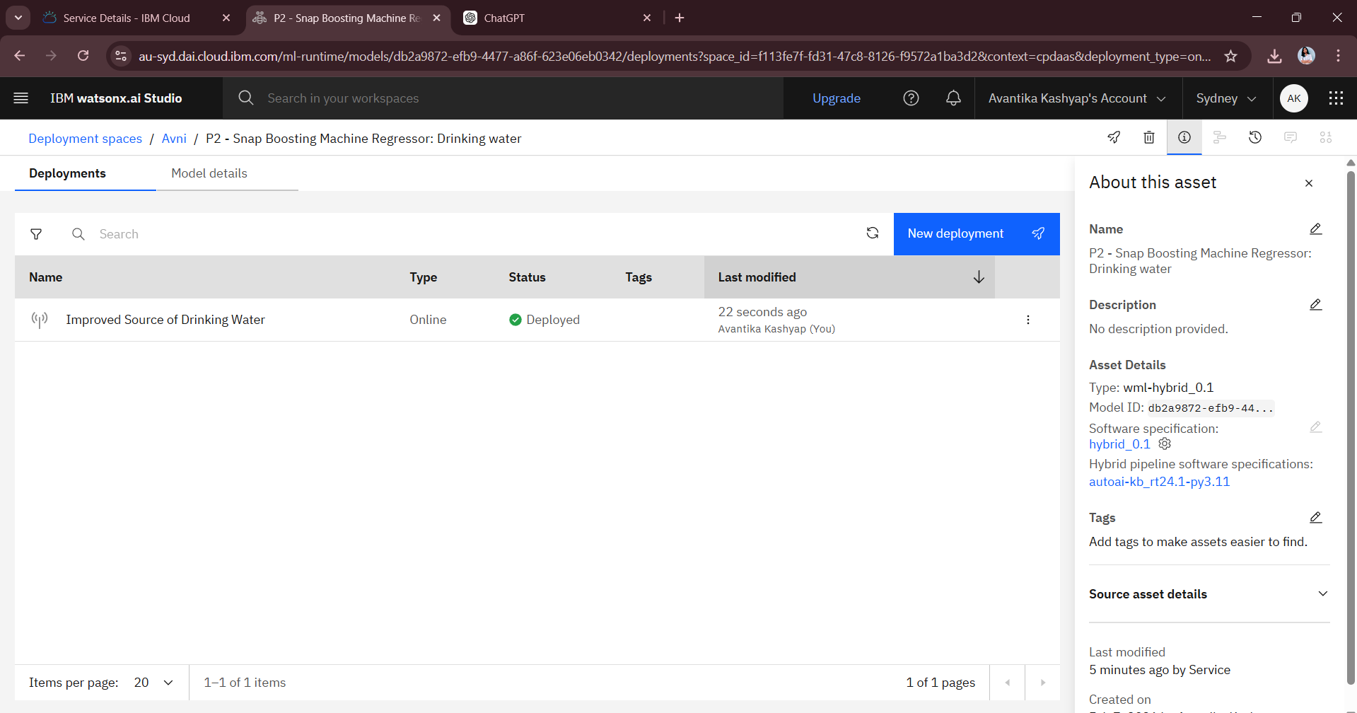
Result

Slide 11
result

Slide 12
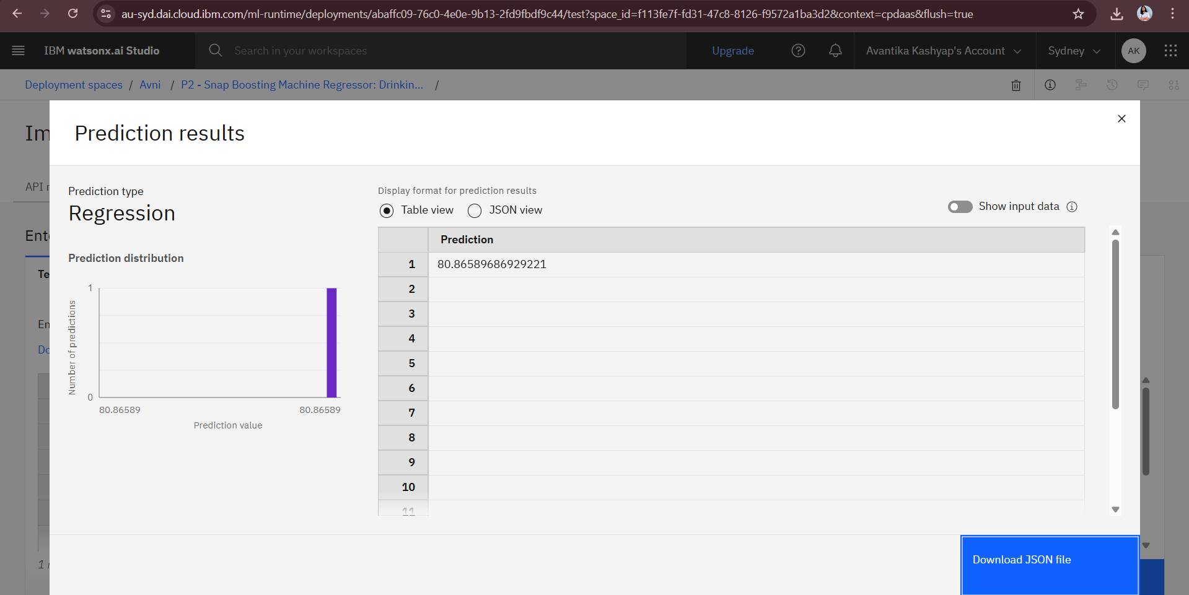
result

Slide 13
Conclusion
The study highlights significant disparities in access to improved drinking water across regions and socio-economic groups in India.
Rural and underdeveloped areas still face challenges in obtaining safe and reliable water sources.
The analysis shows that access to clean cooking fuel and migration patterns are closely linked with water accessibility.
The project provides data-driven insights that can support policymakers in designing targeted and effective water supply programs.
Improving water accessibility will help India achieve Sustainable Development Goal (SDG) targets and promote better public health and living standards.

Slide 14
Future scope
The study can be expanded by including data from future MIS or national surveys for more accurate and updated analysis.
Advanced machine learning and AI models can be applied to improve prediction accuracy.
Integration of geographical and climate data can help in better understanding water availability challenges.
The project can be developed into a real-time monitoring dashboard for policymakers and government agencies.
Further research can explore the impact of water accessibility on health, education, and economic development.

Slide 15
References
Ministry of Statistics and Programme Implementation (MoSPI), 78th Round Multiple Indicator Survey (MIS) Report, Government of India.
United Nations, Sustainable Development Goals (SDG) – Goal 6: Clean Water and Sanitation.
World Health Organization (WHO) & UNICEF, Joint Monitoring Programme (JMP) for Water Supply, Sanitation and Hygiene.
Government of India, Jal Jeevan Mission Reports and Guidelines.
Research articles and publications related to drinking water accessibility and socio-economic indicators in India.

Slide 16
Github link
https://github.com/Avantika-200411/edunet-ibm

Slide 17
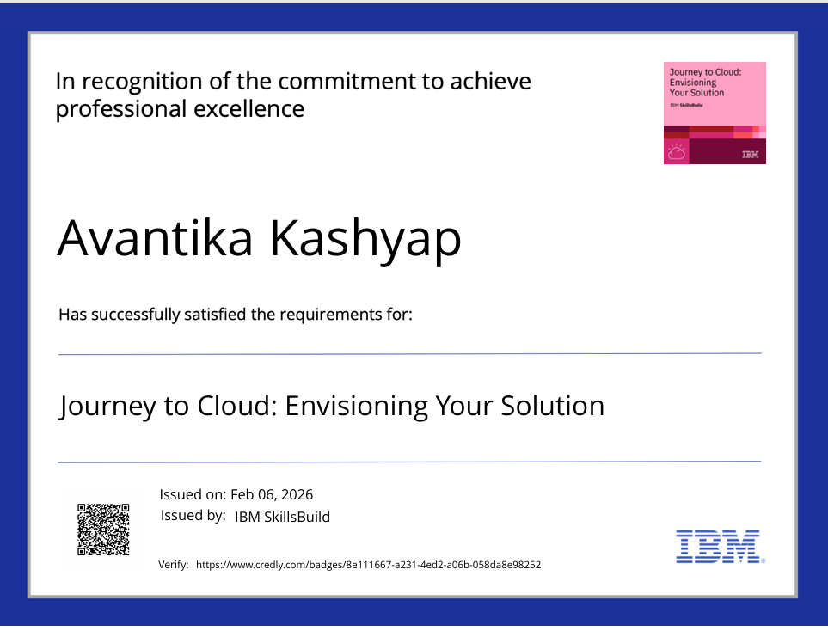
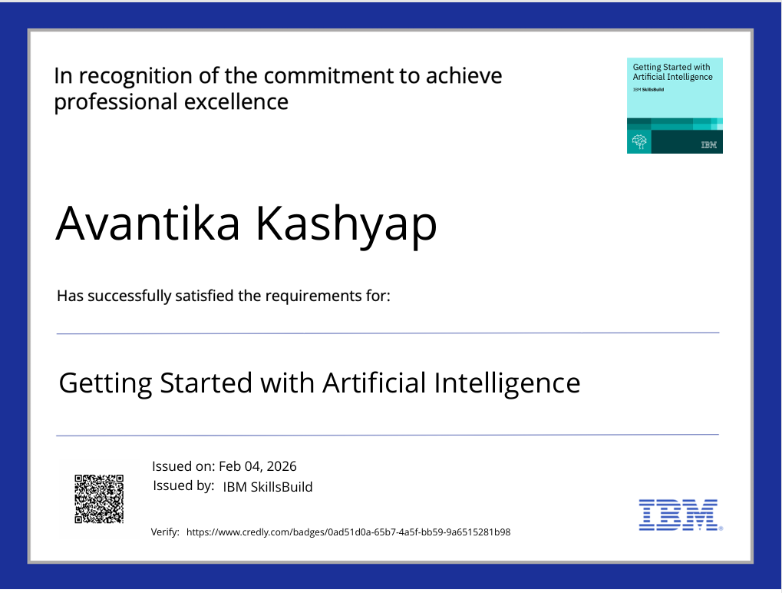
certificates

Slide 18
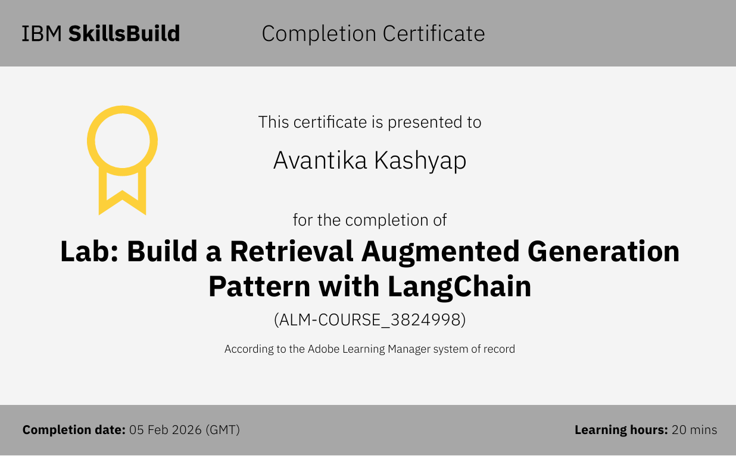
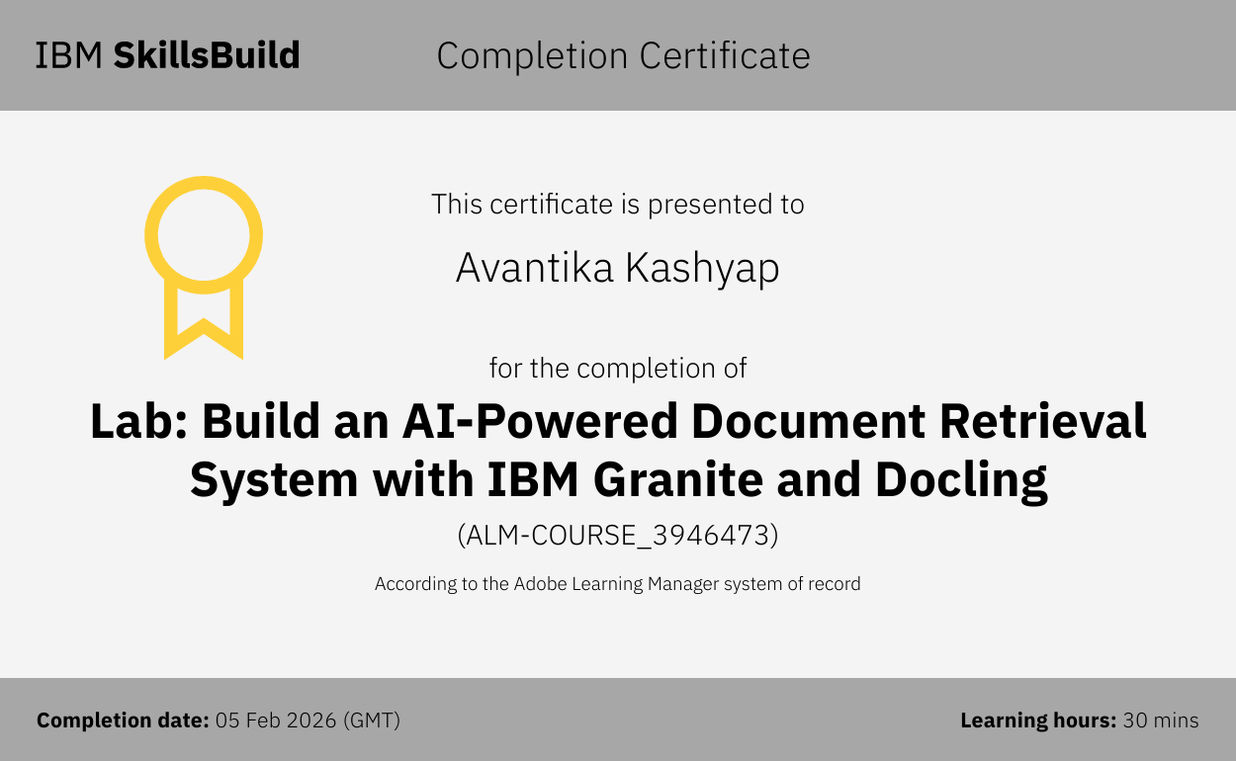
certificates

Slide 19
THANK YOU

